Slide 1


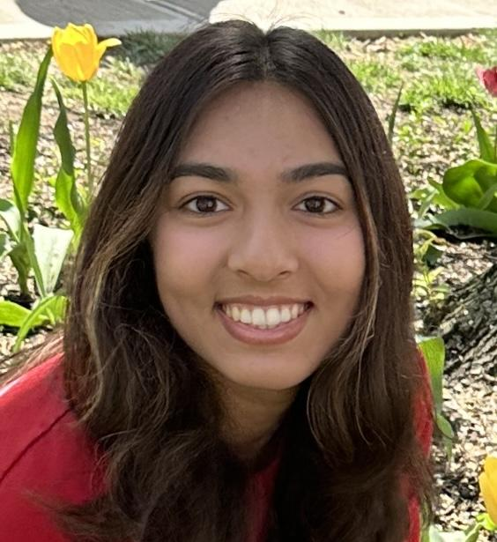
Aidan Dilsavor
Greg Harrigle
Ummehani Motiwala
3rd Year
3rd Year
3rd Year
Data Analytics
Data Analytics
Data Analytics
dilsavor.6@osu.edu
harrigle.1@osu.edu
motiwala.6@osu.edu

Slide 2
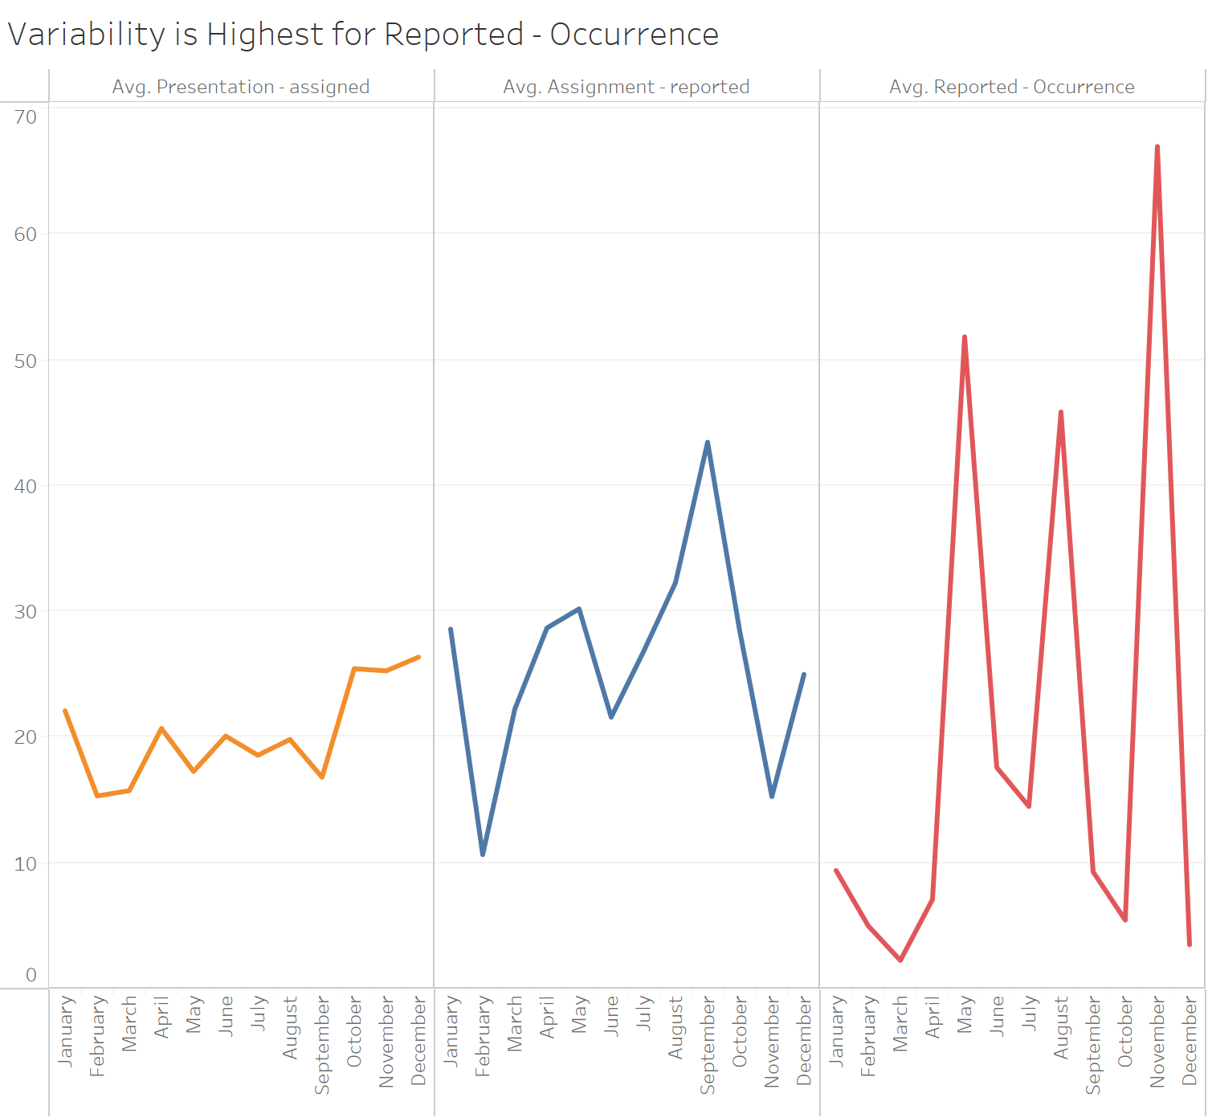
SE Data Set: Analyzing time differences
Average for Presentation - Assignment: 20.0 days (19.71 days w/o outliers)
Average for Assignment - Reported: 28.31 days (24.98 days w/o outliers)
Average for Reported - Occurrence: 21.31 days (7.178 days w/o outliers)
Source: Greco Class SE Data Set.xlsx, n = 132

Slide 3
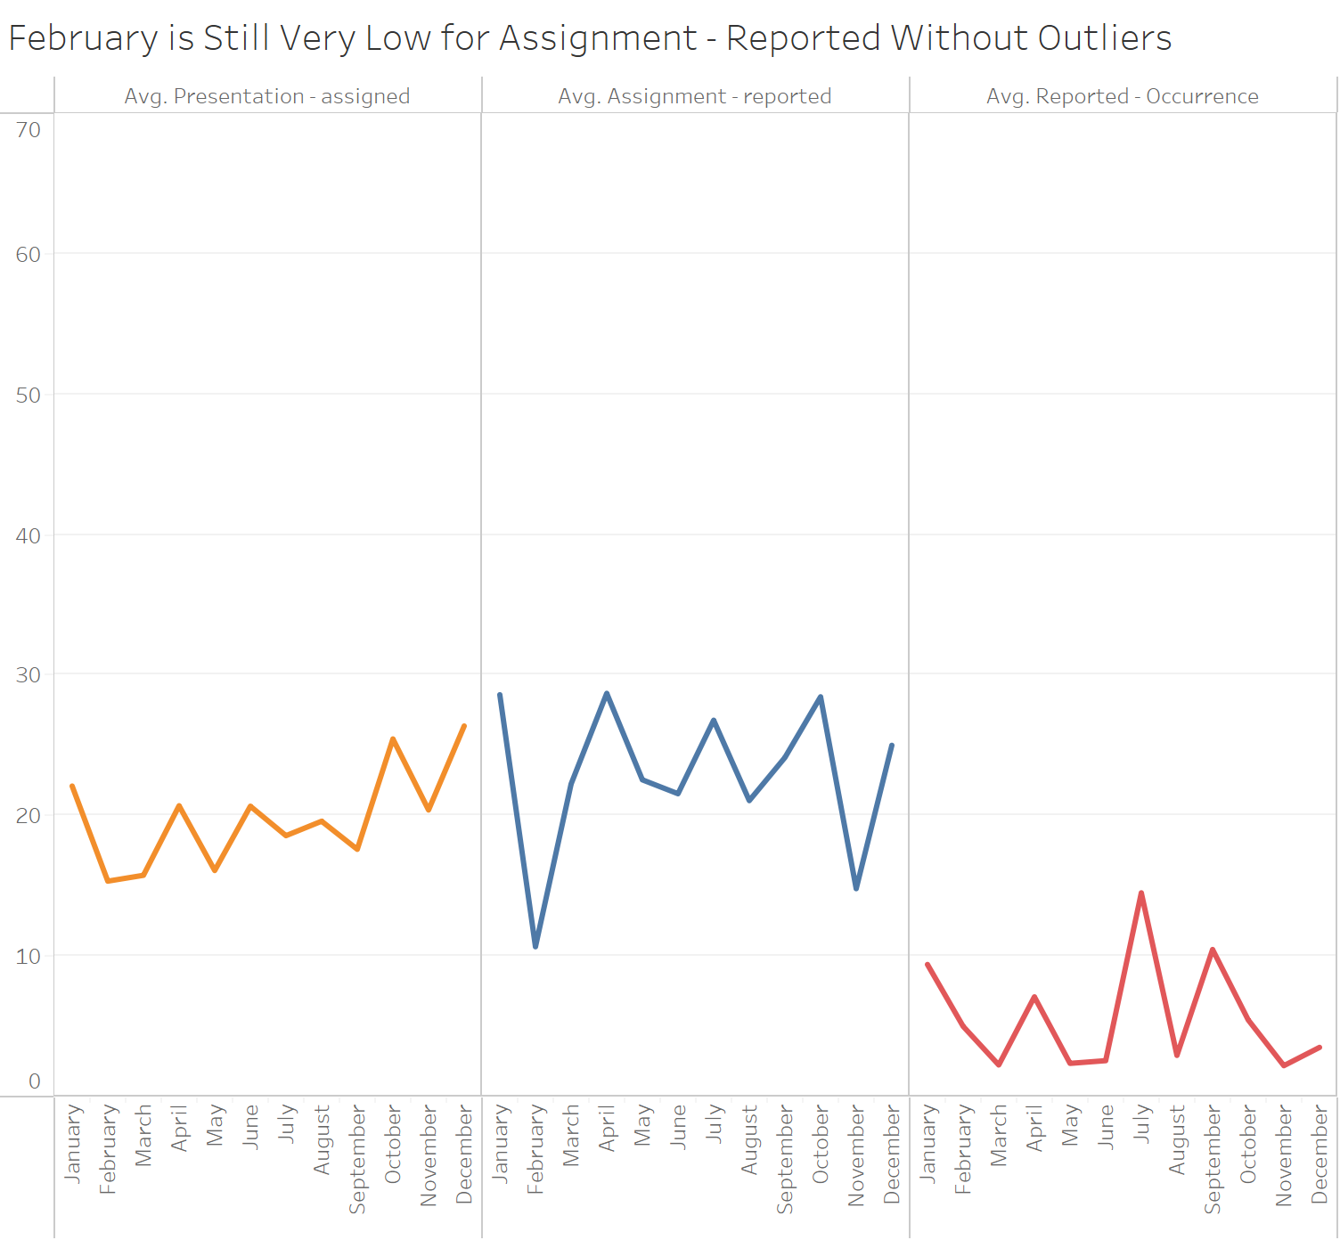
SE Data Set: Analyzing the timeline without outliers
Reported - Occurrence looks drastically different and lower
Presentation - assigned looks largely the same
The averages of each category look much more accurate now due to the decrease in variability
Source: Greco Class SE Data Set.xlsx, n = 122

Slide 4
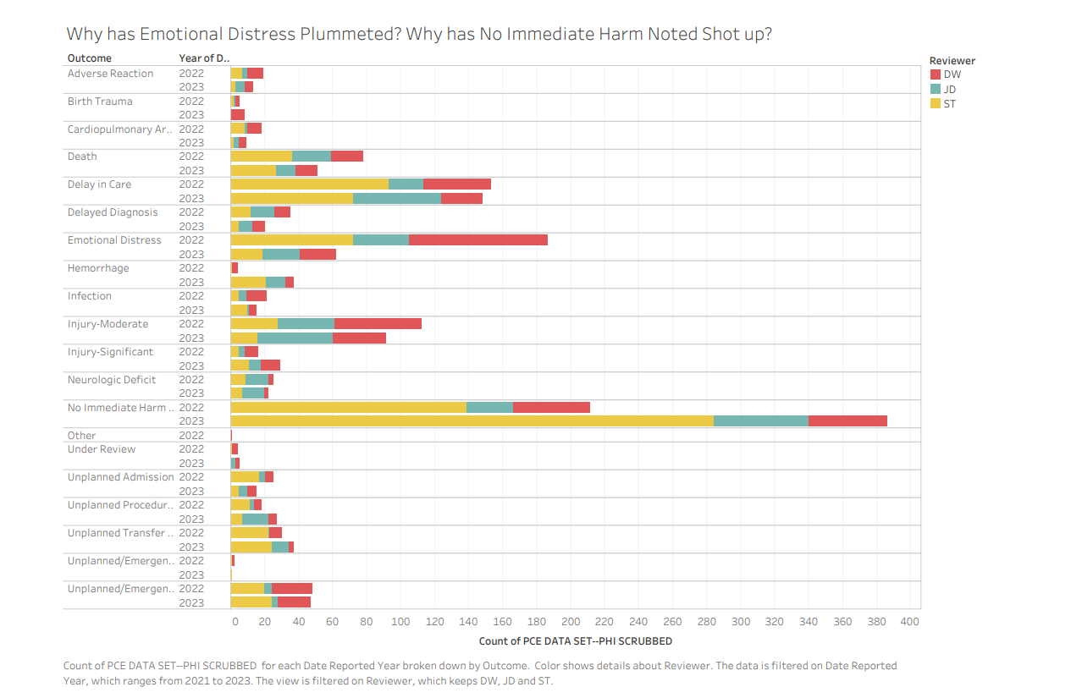
PCE Data Set: Changes in Trends
ST’s rate of choosing “No Immediate Harm” has drastically increased in 2023.
ST and DW both have chosen emotional distress at MUCH lower rates than in 2022.
Why could this be? They should be relatively consistent by year - could be from policy change, bias, etc.
Source : GRECO PCE CLASS DATA SET.xlsx - filtered for 2022 and 2023, with reviewers DW, ST, JD.

Slide 5
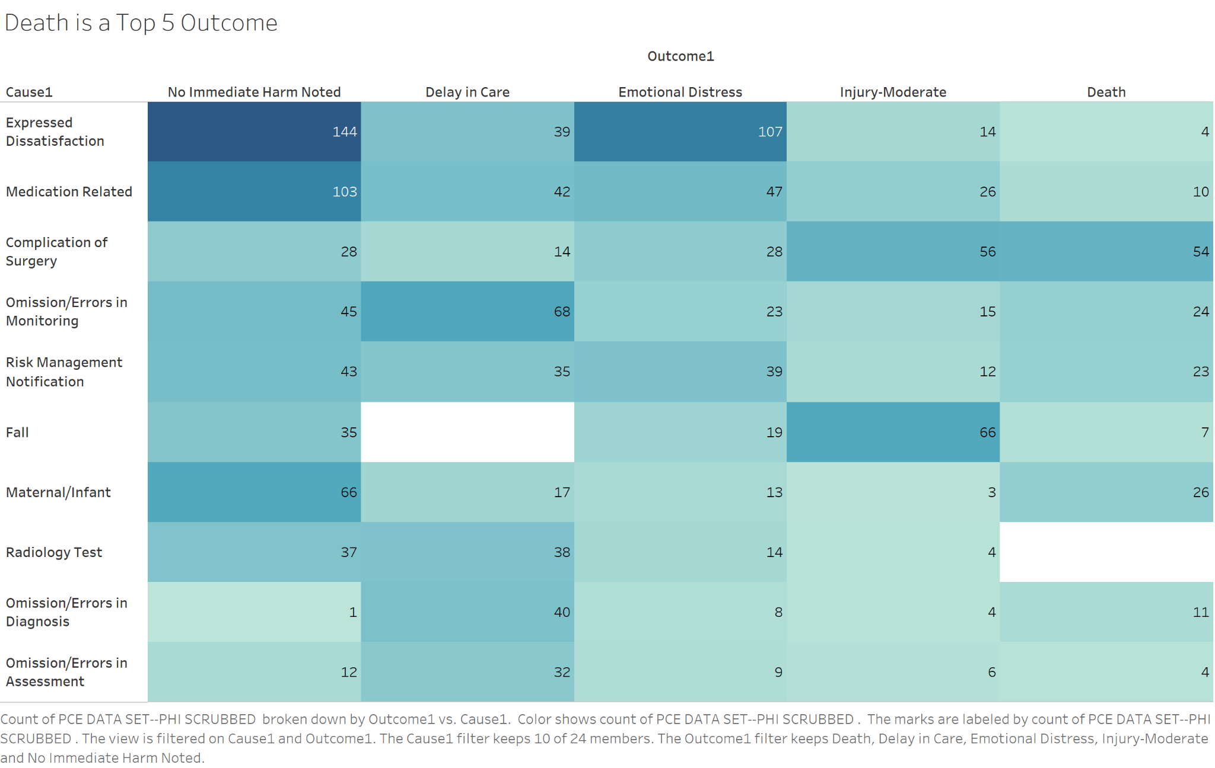
PCE Data Set: Causes vs Outcomes
Majority are expressed dissatisfaction with no harm noted, which is good
Out of 20 different outcomes, death is one of the top 5
Significant amount of medication related causes, which could easily be prevented with more measures put in place
Why is falling in a hospital so common? It causes the most moderate injuries. There should be guard rails on beds and escorts for walking to prevent this
Source: GRECO PCE CLASS DATA SET.xlsx, n = 1515

Slide 6
Next Steps
Provide patient demographics (age, gender) and amount of money associated with the court case. This would likely provide valuable knowledge if recorded.
Provide better guidelines for rankings + outcomes. Ambiguity (what we saw in “Changes in Trends” and “Causes vs. Outcomes”) will cause confusion and make the process less consistent, inherently increasing time during the entire process.
Work to eliminate the “mistakes” in the mistake reporting process. The majority of events have fairly efficient reporting and reviewing processes, but there are far too many events that have timelines extending into years of duration (Ex. Outliers in “Analyzing Time Differences”).
The time from date reported to date assigned takes the longest on average, when this should be a rather quick process (“Analyzing Time Differences”). Reviewer/presenter specializations may facilitate this process since it would be easier to assign certain events to certain people (Appendix 1 + 2).

Slide 7
Appendix

Slide 8
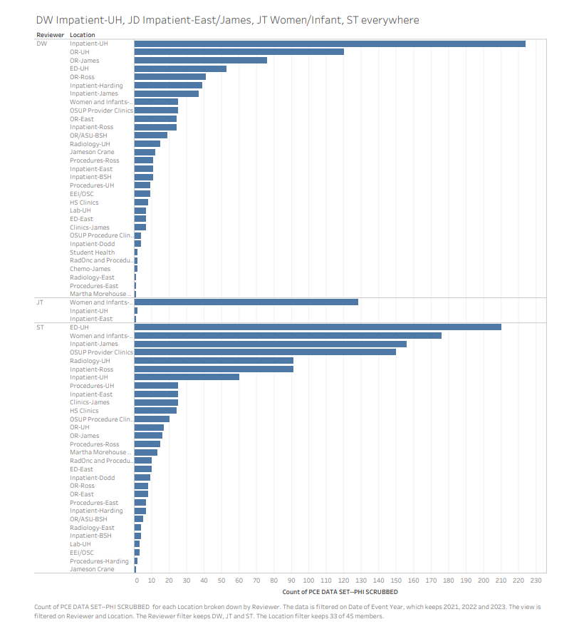
Appendix 1 : Specializations?
Through the data, it appears that some, not all, reviewers specialize in certain departments.
Having multiple reviewers judge the same department could cause differences in consistency and time.
Source : GRECO PCE CLASS DATA SET.xlsx - filtered for 2021, 2022, and 2023, with reviewers DW, ST, JD.

Slide 9
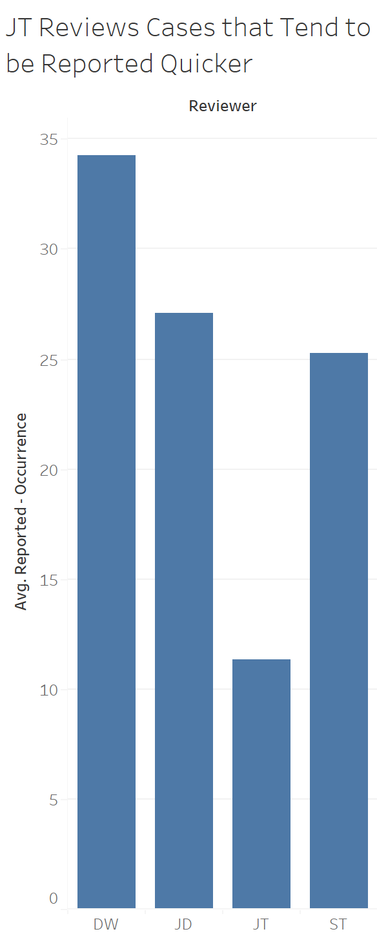
Appendix 2 : Reported - Occurrence Split by Reviewer
While JT does have less incidences reviewed than the other three main reviewers, he/she still has enough for the obvious disparity here to be notable
DW on average reviews the events with the highest reported - occurrence days
Source: Greco Class PCE Data Set.xlsx, n = 3,198

Slide 10
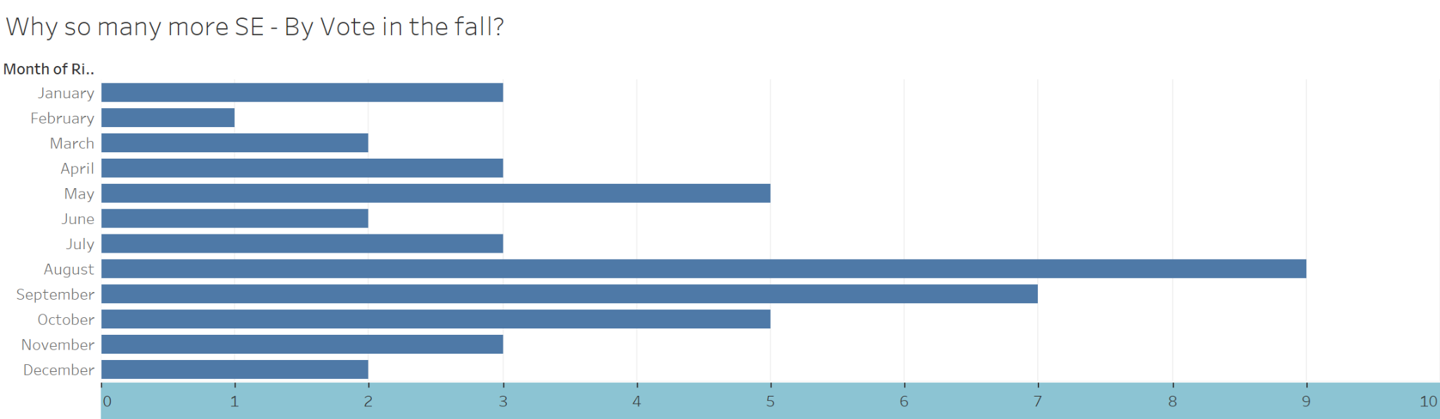
Appendix 3 : SE - By Vote Split by Month
The other designations had a much more even spread across the months
Slight peak around May as well as the fall months
Only one SE - By Vote in February while there were nine in August
Source: Greco Class SE Data Set.xlsx, n = 132

Slide 11
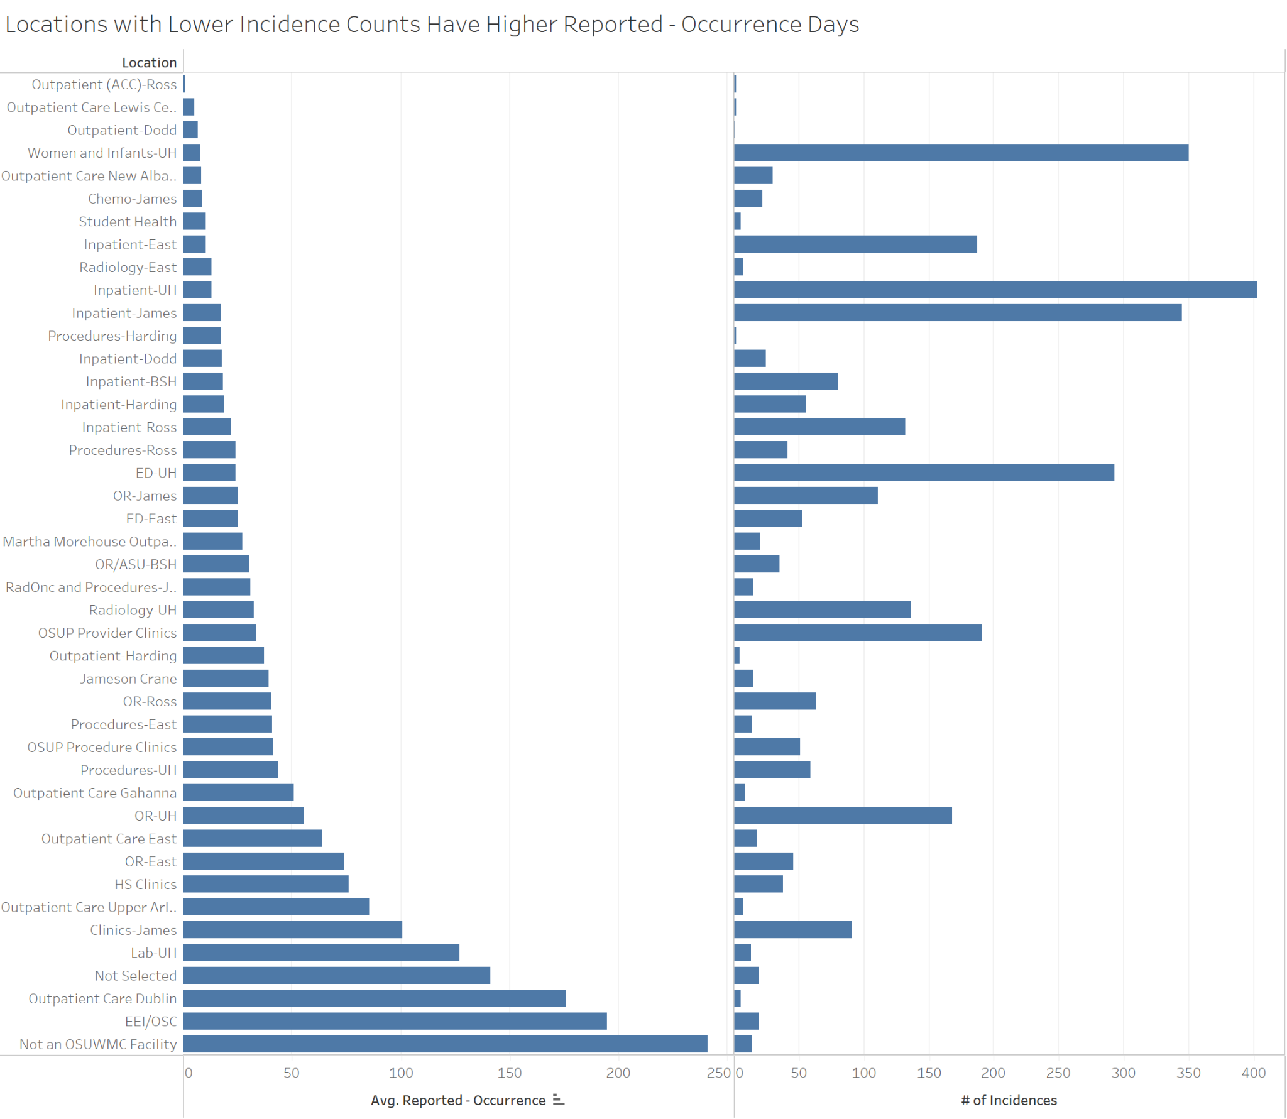
Appendix 4 : Counts and Reported - Occurrence Split by Loc.
Clinics James has fairly high count and reported - occurrence days
There are multiple locations with low count and low number of incidences, such as Outpatient Dodd, Student Health, etc.
While the trend is not clear cut, the reported-occurrence days and number of incidences does tend to have a slight inverse relationship
Source: Greco Class PCE Data Set.xlsx, n = 3,198

Slide 12
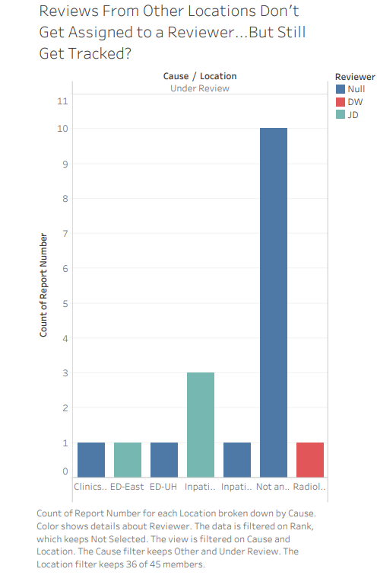
Appendix 5: Point of tracking Non Applicable Locations?
Why are we keeping track of locations non-affiliated with Ohio State, especially when they aren’t being reviewed by one of our reviewers?
These account for 10 instances of the outcome “under review” - these could be affecting our review times, because they aren’t being assigned to a reviewer.
Source : GRECO PCE CLASS DATA SET.xlsx - filtered for 2022 and 2023, with reviewers DW, ST, JD.

Slide 13
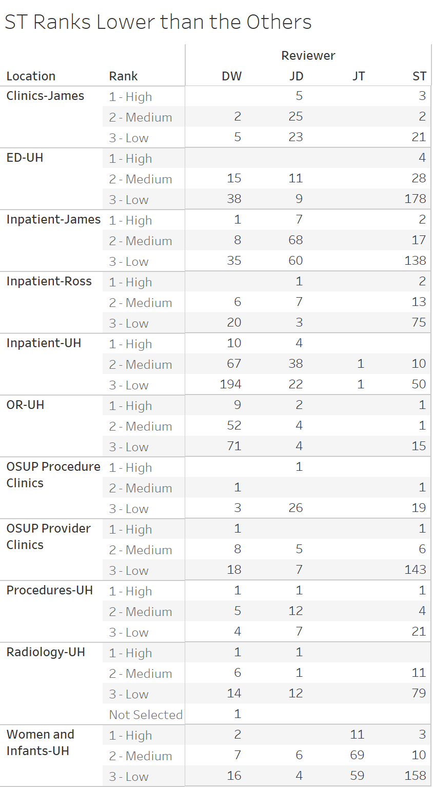
Appendix 6: Reviewer Ranks Split by Location
Even when split by location, we see a clear difference in ratio of high/low/medium from ST to the other reviewers
This essentially proves the following slide that shows ST ranks lower than everyone else.
Source: GRECO PCE CLASS DATA SET.xlsx, n = 2,155

Slide 14
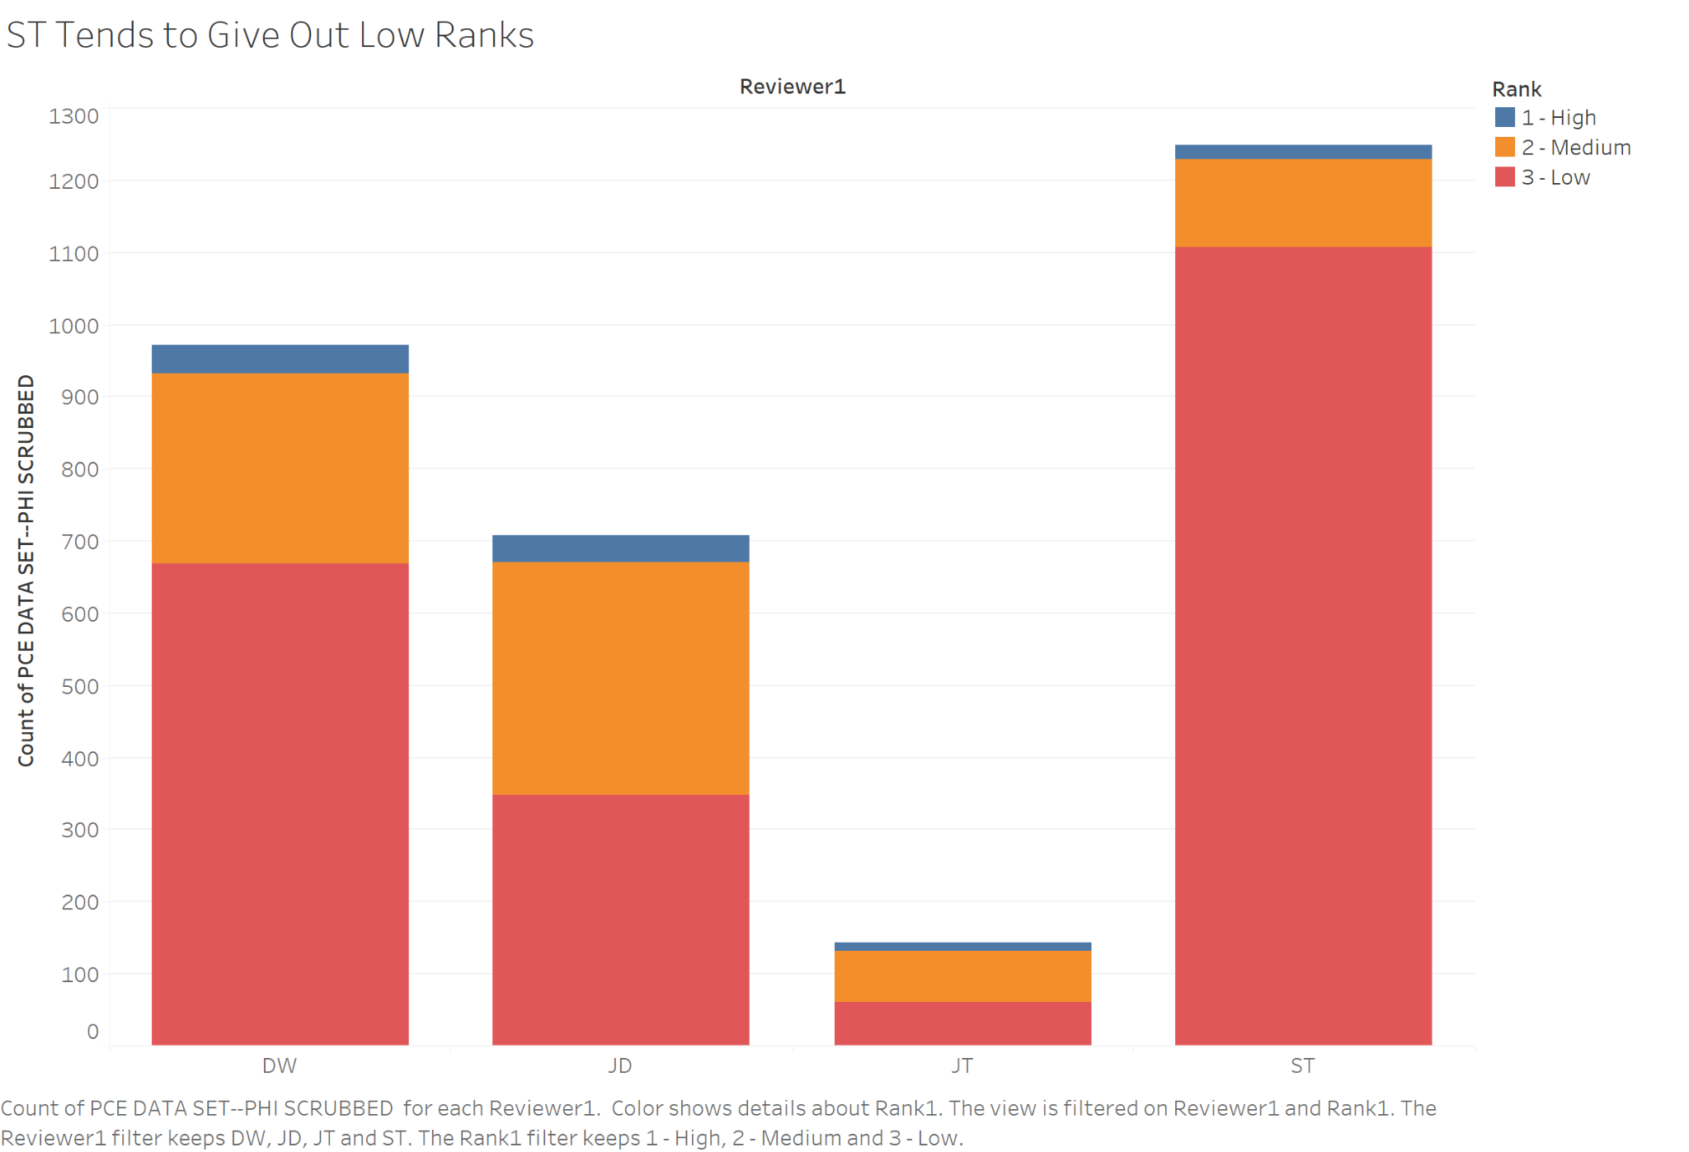
Appendix 7: Reviewer Ranks General
Clear difference in ratio of high/low/medium from ST to the other reviewers
ST has reviewed the most reports and given out the most low ranks
Each reviewer’s opinion and potentially experience seems to play a large role in what rank they give, maybe there should be guidelines in place for consistency
Source: GRECO PCE CLASS DATA SET.xlsx, n = 3072

